Slide 1


James A Robertson and Associates
Effective Strategic Business Solutions
Executive Custody
what is it and
how do you get it?
Live On-line Presentation (Webinar)
18 January 2013
Dr James Robertson PrEng
The ERP Doctor
Copyright 2004 through 2013
James@JamesARobertson.com
Notes:
NB remember to have a chair to stand on
Make sure to take the CRITICAL FACTORS BOOK with you
An engineer with a PhD in engineering

Slide 2
Agenda
Executive Custody -- what is it and
how do you get it?
Context and definitions
What IS Executive Custody
What is NOT Executive Custody
Why the CEO MUST be custodian of strategic change (and therefore ERP) projects
How to support the CEO to make this practical
Some simple techniques
Summing up

Slide 3
Agenda
Executive Custody -- what is it and
how do you get it?
Context and definitions

Slide 4
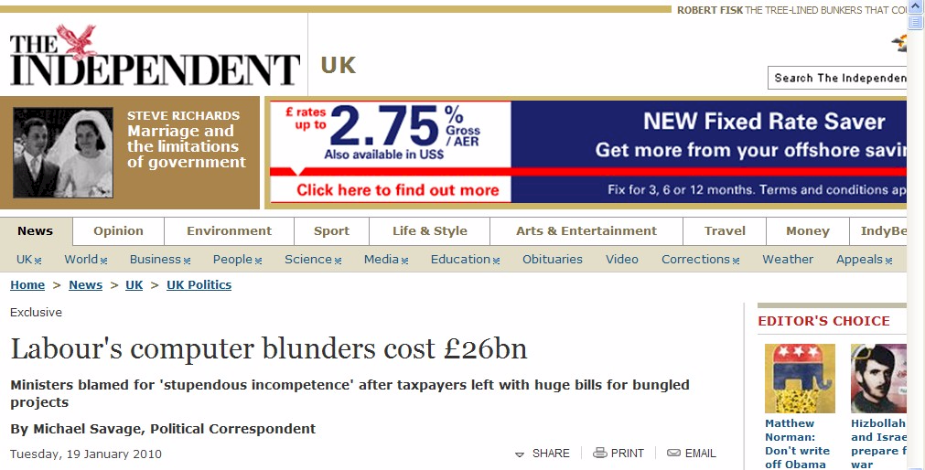
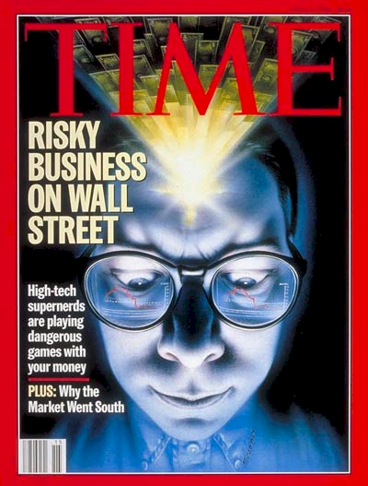
Failures are increasing
The threat and therefore the opportunity is huge
Including clinical integration project

Slide 5
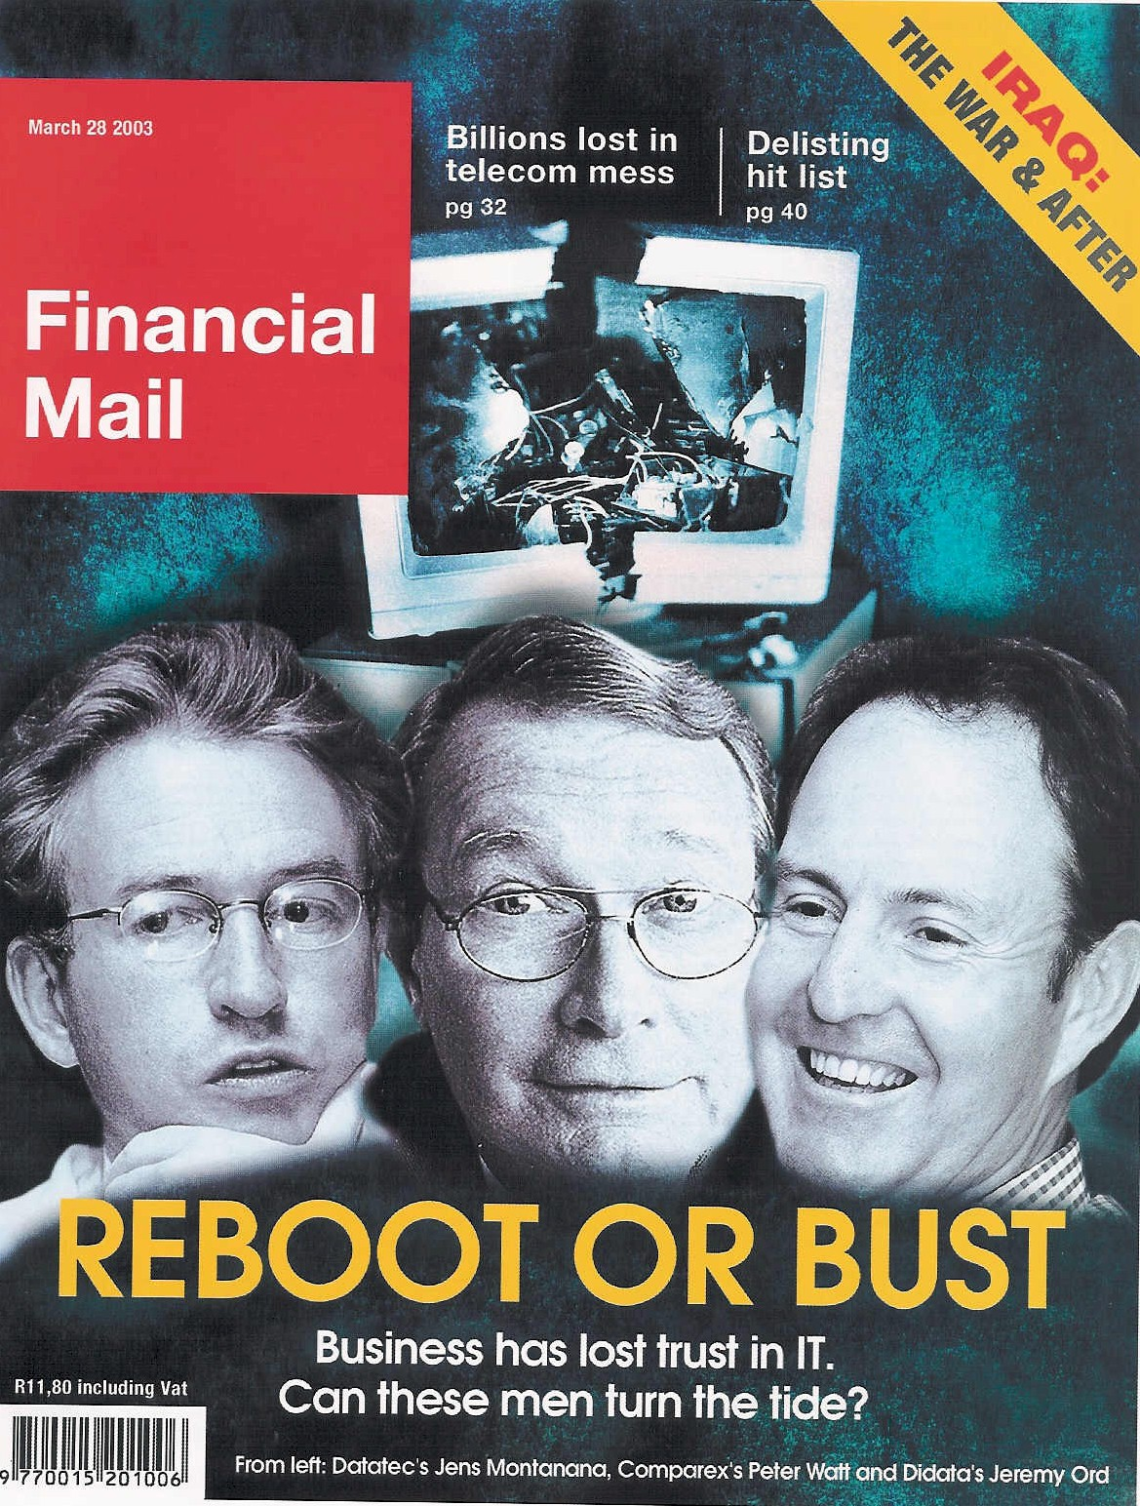

ERP an industry in crisis
Executive Opinion
“19 out of 20 ERP (integrated business information system) implementations do NOT deliver what was promised”
Notes:
An industry in Crisis -- Quote from Duncan McLeod, Financial Mail, 28 March 2008 -- Seven years and half a billion dollars -- Dow Chemicals Company -- $400 million – Nike -- Disney -- $878 million
-- 70% of business IT projects fail outright – another 20% materially fail to meet the business expectation – 70% of BPR projects fail and 90% of strategic plans fail to deliver

Slide 6
An industry characterized by failure
A strategic executive outcome
"Attendees of Gartner's Business Intelligence Summit in London last month were not surprised to hear that most enterprises are still failing to use business intelligence (BI) strategically. Gartner's survey of over 1300 CIOs returned some unimpressive findings about the state of BI implementations: Gartner's vice: president of research summed up the situation nicely by saying:
“Most organisations are not making better decisions than they did five years ago”
BUSINESS INTELLIGENCE
Article published in Computer Business Review Africa.

Slide 7

One of the classic business problems of this age
We have spent a FORTUNE on this computer system and I.T. tell me it will take two years and another few million to get what I want BUT the transactions are being processed already

Slide 8

Some harsh facts
Seventy percent of I.T. investments fail TOTALLY
"19 out of 20 E.R.P. implementations “do not deliver what was promised“
Seventy percent of B.P.R. investments fail
Ninety percent of strategic plans fail
Notes:
KEEP SHORT AND SIMPLE
MY FATHER
How did i get involved with computers? – my father was a visionary -- In 1981, having gathered over 7,000 pages of research data for my PhD the University mainframe did not have space to store even one page of data. My father purchased me one of the first desktop PC’s in the days of the Apple and Apricot and 123, etc – at a cost of R12,000 two and a half times my research grants! – I very quickly discovered that there was a HUGE gap between what the salesman told me the computer could do and getting it to do it – so, in that respect, NOTHING HAS CHANGED ☺ -- I then put myself through a self taught computer science programme and learned to program, learned to type and finally wrote an award winning PhD thesis – at the same time I computerized my father’s investment consulting business and we were able to double turnover in twelve months and create an enduring revenue stream that lasted for over ten years because we were able to do things that much larger businesses were not able to do – it was then that I began to understand that the strategic application of information technology COULD deliver great value and one of my greatest frustrations is the extent to which few businesses achieve this potential – the rest of this presentation is about lessons I have learned that I hope will help YOU to make a difference in your business with IT

Slide 9
A classic practical example
NO CEO Custody
CEO of very big listed corporation in Johannesburg
With very big installation
Of very big brand ERP
Used in advertising
“At the executive level I would rate my systems at 1/10”
“At the operational level I would rate my systems at 7/10”
1/10
BUT even that is being done with smoke and mirrors!
7/10

Slide 10
Top down (CEO led) versus bottom up design
Top Down – Strategy Focused
Bottom Up – Process Focused

Slide 11

There IS great opportunity
ERP can and should add value
Notes:
Professor Richard Nolan states that "I.T. is the next corporate disaster waiting to happen”
And postulates that soon there will be an Enron level corporate failure
Do you remember Fedsure Health – tell the story SHORT

Slide 12
Three alternative ERP value scenarios
CEO Custody is VITAL
X 10+
30+
3. Strategic customization
With CEO Custody
2. Precision configuration with CEO Executive Custody
This is the ONLY valid scenario but it seldom occurs
X 5
20
1. Current view of best practice
X 1
10
Relative value
0
0
0

Slide 13
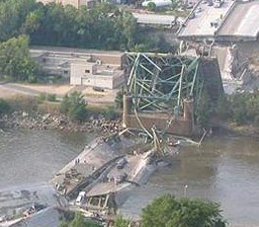

Engineers do NOT design bridges to stand up
Notes:
DHL, Prochem,

Slide 14
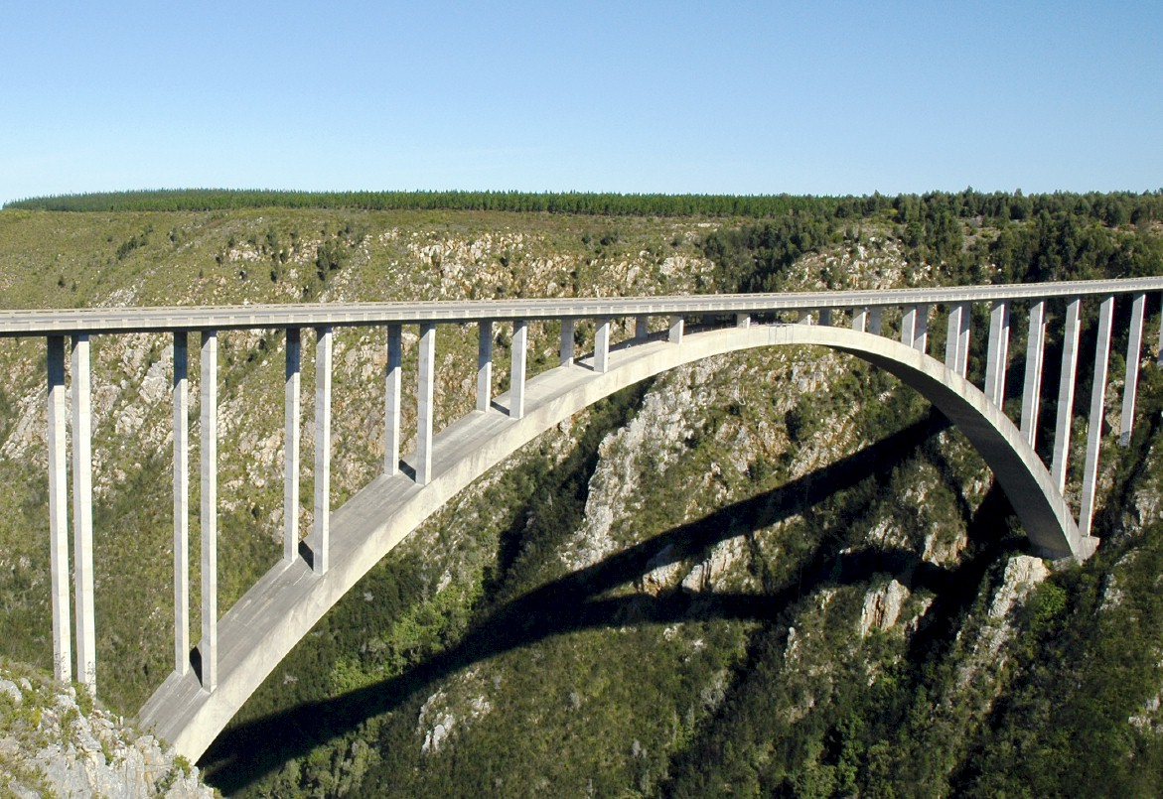
They design bridges NOT to fall down
Notes:
There is a fundamental difference in approach when one designs a bridge NOT TO FALL DOWN
Contrast this with the IT paradigm which could be called “designed to fail”

Slide 15
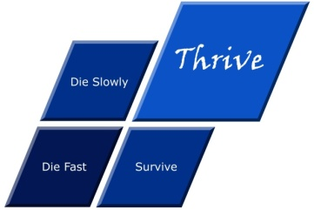




What is strategy?
An executive responsibility
Die fast
Thrive
Tactics – Doing things right ➔
Die slowly
Survive
Strategy – Doing the right things ➔
Professor Malcolm McDonald.

Slide 16
What IS Strategy?
The Essence of WHY the Organization exists and HOW it THRIVES

Slide 17
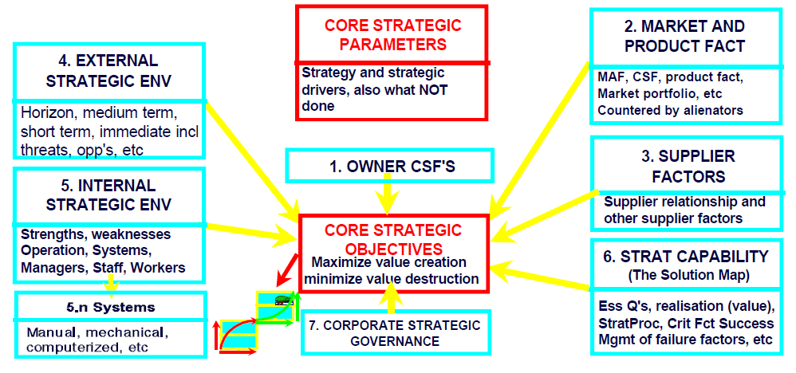
Analysis of the strategic environment
The CEO owns this view

Slide 18
Agenda
Executive Custody -- what is it and
how do you get it?
Context and definitions
What IS Executive Custody

Slide 19
How I learned that CEO Executive Custody was critical
First ERP Project
  CEO took custody
  Full support to guide and direct the project
  Open door to CEO
Next two ERP projects NO CEO involvement at all -- disasters
Next ERP project – major shareholder, operational executive AND CFO – went very well but STILL problems with the CEO later
Various scenarios over many years
Investigated many failed and sub-optimal projects
Arrived at conclusion that CEO Custody was vital
Project with exceptional CEO Custody created platform for 25% increase in turnover

Slide 20
The essence of WHY CEO Custody is NOT NEGOTIABLE
Traditional Governance
CEO
CFO
Operations
HR Exec
Marketing
etc
CIO?!
/CFG
FM

Slide 21
The essence of WHY CEO Custody is NOT NEGOTIABLE
Recommended Governance
CEO
CIO
CFO
Operations
HR Exec
Marketing
etc
Strategic Advisor / Solution Architect
FM

Slide 22
Factors causing ERP failure

Slide 23
Factors for ERP reimplementation success

Slide 24


The value of technology is determined by the person using the technology
Notes:
A gun is neither good nor bad
If it is held by a person you regard as good and pointed at a person you regard as bad the gun is good
BUT if it is pointed at YOU it is always BAD!

Slide 25
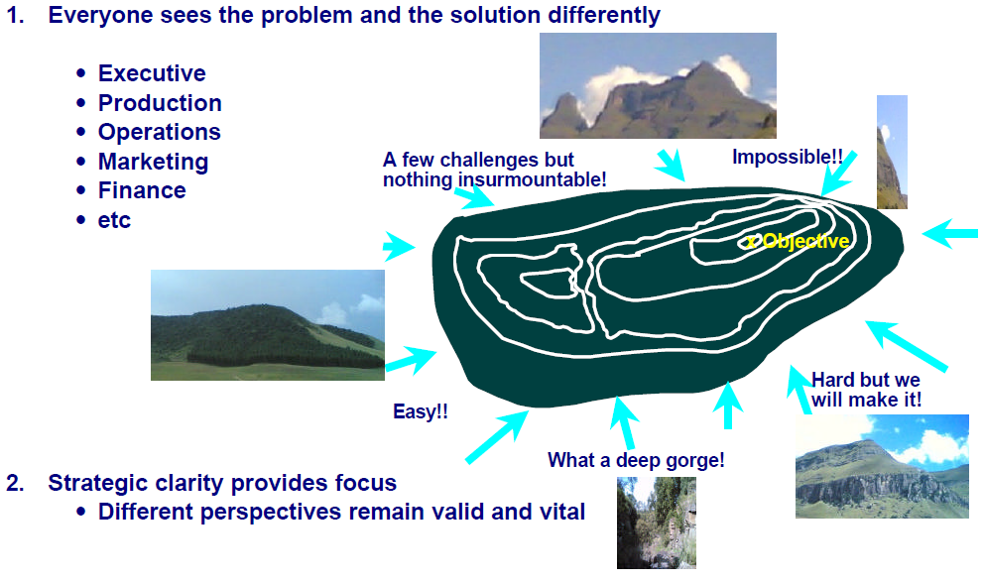
The problem of different perspectives
BUT the CEO owns the helicopter view

Slide 26
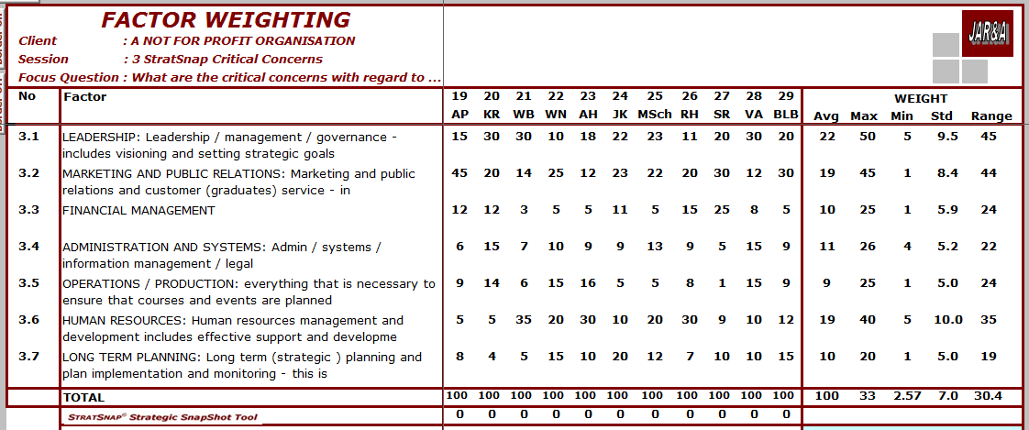
The problem of different perspectives

Slide 27
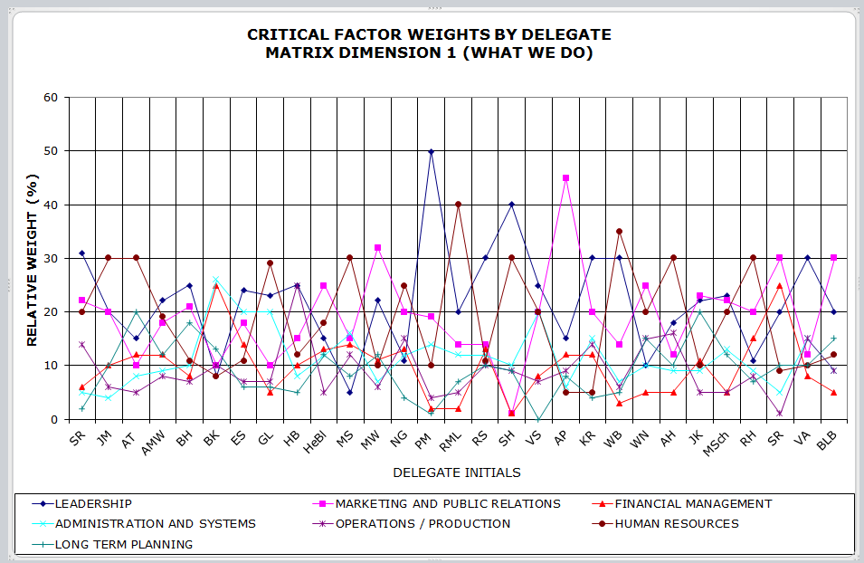
Developing a robust strategic design

Slide 28
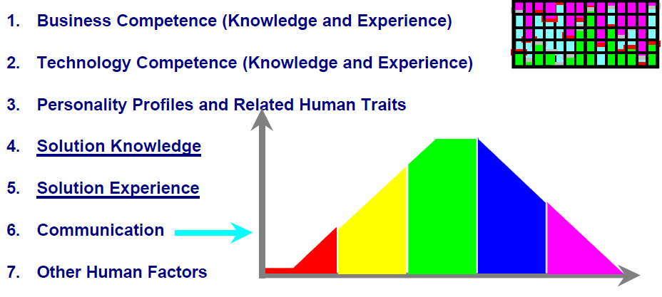
The critical human foundation
The CEO owns the integrated view

Slide 29
The components of achieving Executive Custody
Engagement -- 30%
Leadership -- 50%
Prove it works -- 5%
Make it work -- 15%
Notes:
Professor Richard Nolan states that "I.T. is the next corporate disaster waiting to happen”
And postulates that soon there will be an Enron level corporate failure
Do you remember Fedsure Health – tell the story SHORT

Slide 30
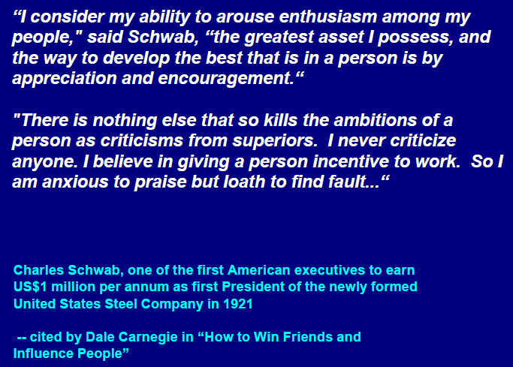
Leadership = enthusiasm through appreciation and encouragement

Slide 31
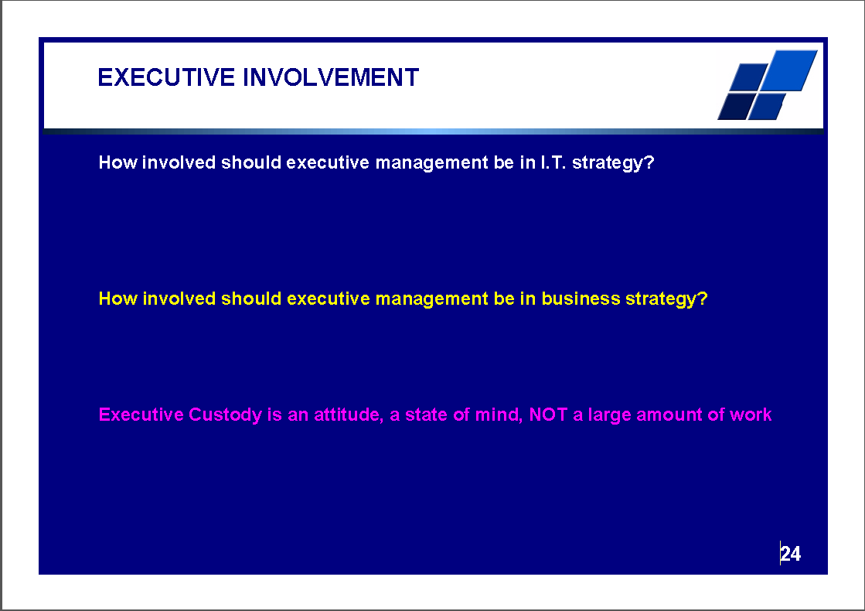
There IS great opportunity
ERP can and should add value
Notes:
Professor Richard Nolan states that "I.T. is the next corporate disaster waiting to happen”
And postulates that soon there will be an Enron level corporate failure
Do you remember Fedsure Health – tell the story SHORT

Slide 32
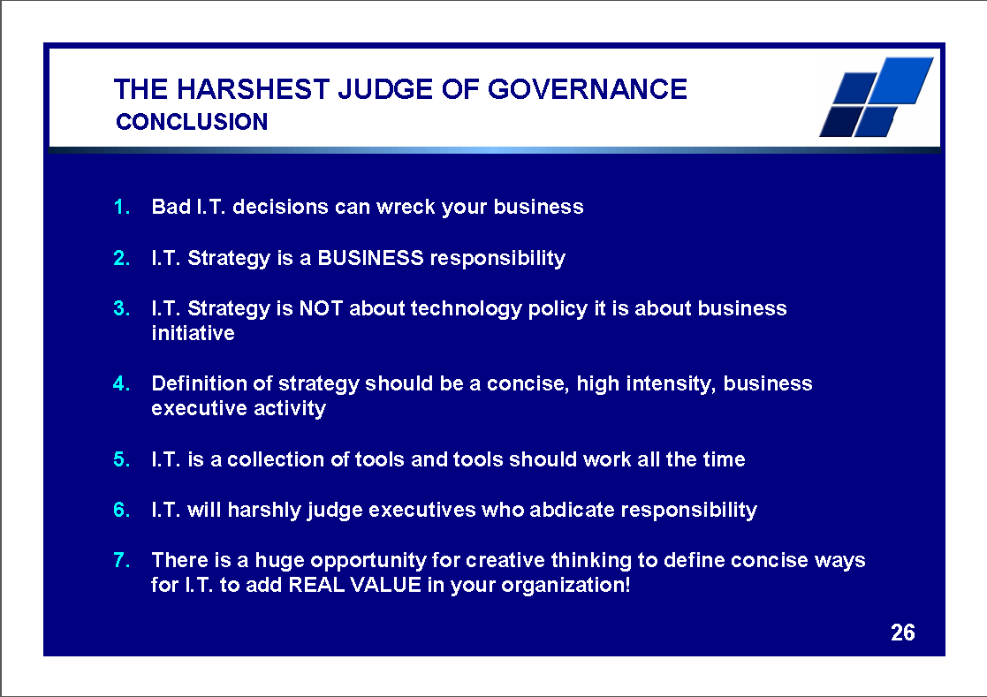
There IS great opportunity
ERP can and should add value
Notes:
Professor Richard Nolan states that "I.T. is the next corporate disaster waiting to happen”
And postulates that soon there will be an Enron level corporate failure
Do you remember Fedsure Health – tell the story SHORT

Slide 33
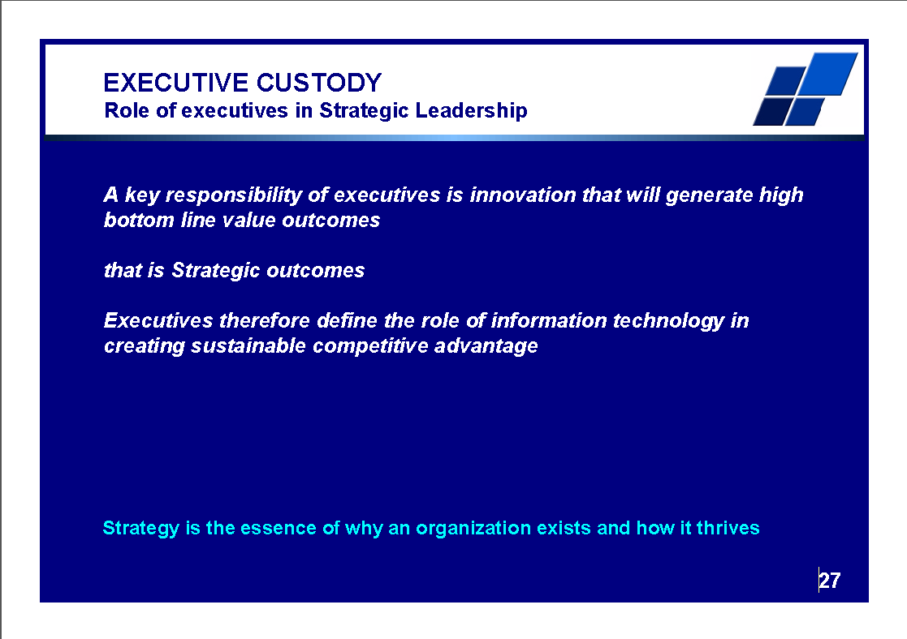
There IS great opportunity
ERP can and should add value
Notes:
Professor Richard Nolan states that "I.T. is the next corporate disaster waiting to happen”
And postulates that soon there will be an Enron level corporate failure
Do you remember Fedsure Health – tell the story SHORT

Slide 34
Agenda
Executive Custody -- what is it and
how do you get it?
Context and definitions
What IS Executive Custody
What is NOT Executive Custody

Slide 35
What is NOT
Executive Custody?
Joe (the IT Manager) understands technology, I do NOT, so I trust him to run with this
Pete (the CFO) understands IT, I do NOT, so I trust him to run with this
John (the Legal Affairs Director) has a knack with computers, so I trust him to run with this
I am going get down and dirty and SHOW you all how this is done (no delegation)
Sit in the chair and constantly bounce issues to others in the room
etc

Slide 36
What IS
Executive Custody?
Clear helicopter view of the desired solution in terms of business outcome
Clear understanding that ONLY he owns this view
Realization that CEO requires an expert to advise in this area and appoints such an expert
Realization that CEO needs a DOER to run the project / ERP operations and that this person needs to sit on EXCO, even if not a full peer
Engage daily to a limited extent to keep in touch and give guidance
Engage weekly enough to have a robust view of where things are going and give clear direction
Take full responsibility for the business outcome and hold others to account too

Slide 37
Agenda
Executive Custody -- what is it and
how do you get it?
Context and definitions
What IS Executive Custody
What is NOT Executive Custody
Why the CEO MUST be custodian of strategic change (and therefore ERP) projects

Slide 38
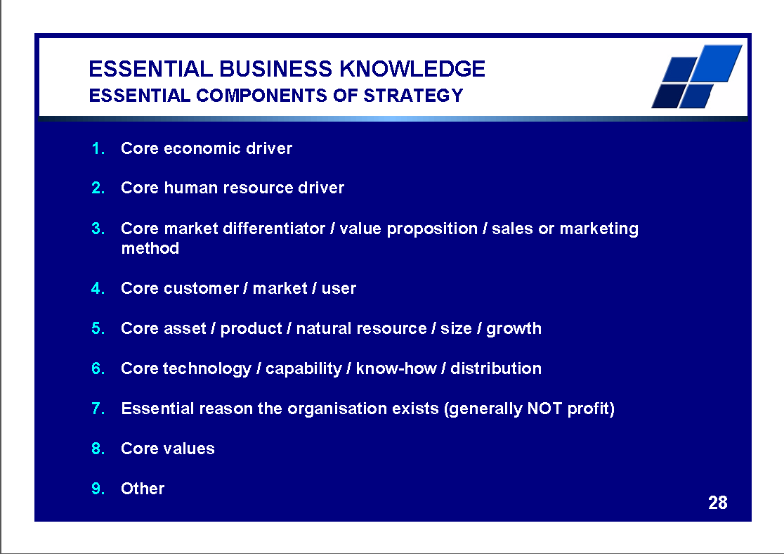
There IS great opportunity
ERP can and should add value
Notes:
Professor Richard Nolan states that "I.T. is the next corporate disaster waiting to happen”
And postulates that soon there will be an Enron level corporate failure
Do you remember Fedsure Health – tell the story SHORT

Slide 39
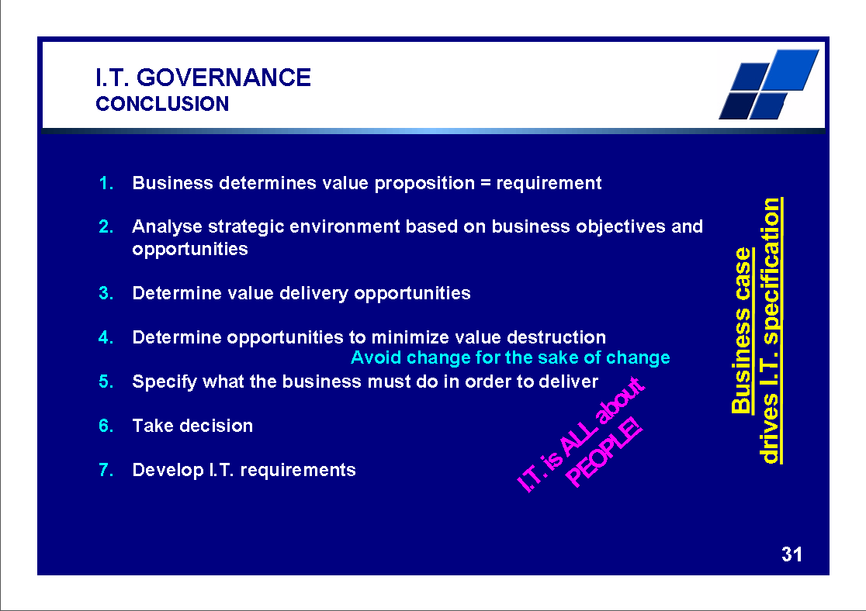
There IS great opportunity
ERP can and should add value
Notes:
Professor Richard Nolan states that "I.T. is the next corporate disaster waiting to happen”
And postulates that soon there will be an Enron level corporate failure
Do you remember Fedsure Health – tell the story SHORT

Slide 40
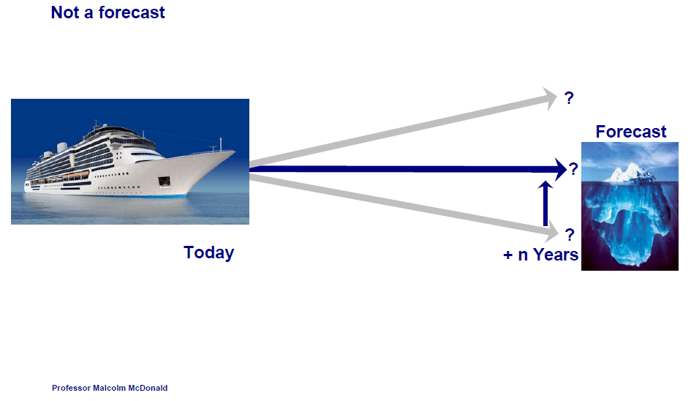
The time dependency of strategy

Slide 41
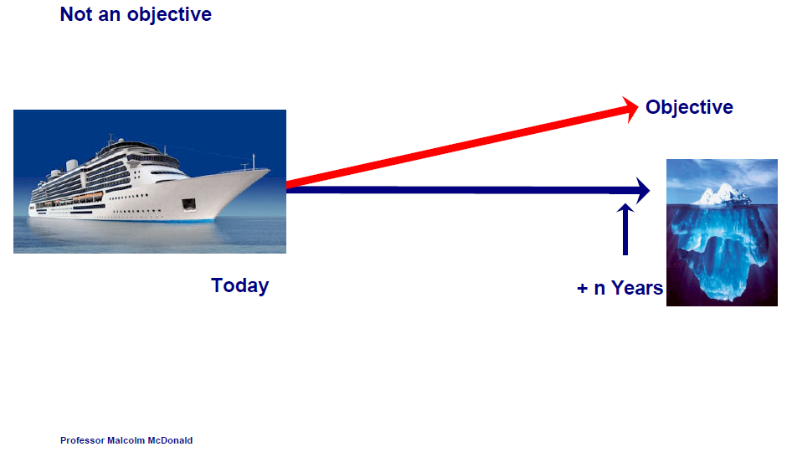
The time dependency of strategy

Slide 42
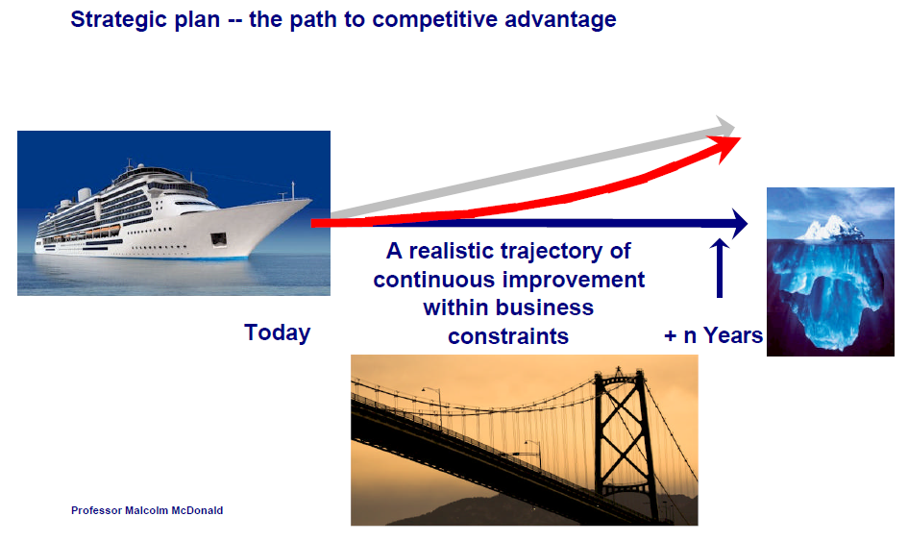
The time dependency of strategy
CEO is the Pilot to steer the journey

Slide 43
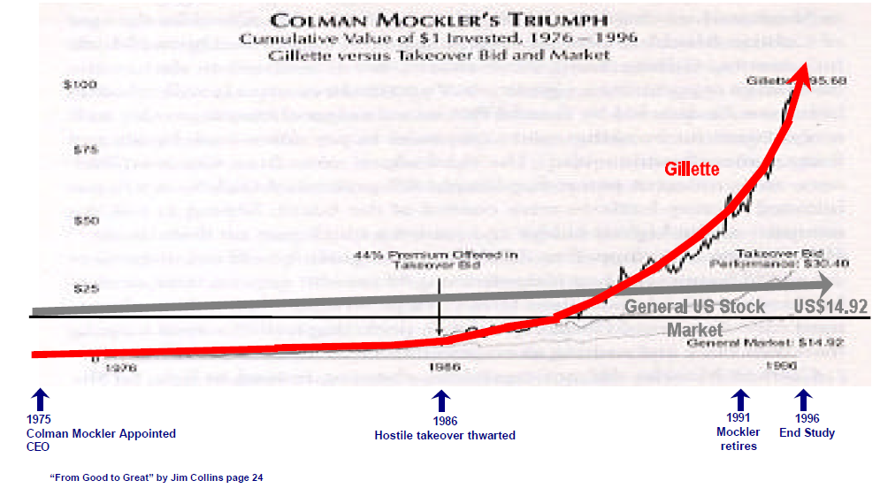
The time dependency of strategy
from good to GREAT
The CEO’s Triumph

Slide 44
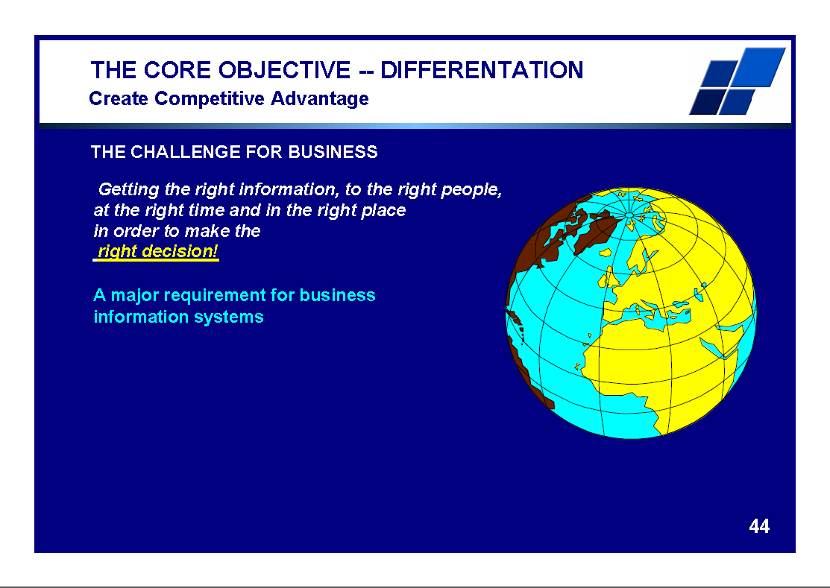
There IS great opportunity
ERP can and should add value
Notes:
Professor Richard Nolan states that "I.T. is the next corporate disaster waiting to happen”
And postulates that soon there will be an Enron level corporate failure
Do you remember Fedsure Health – tell the story SHORT

Slide 45
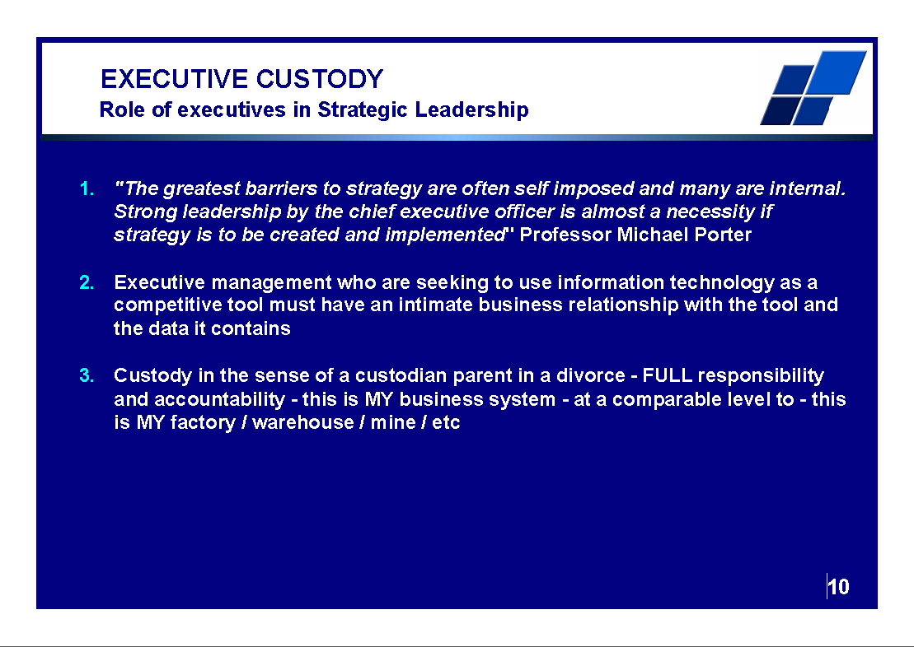
There IS great opportunity
ERP can and should add value
Notes:
Professor Richard Nolan states that "I.T. is the next corporate disaster waiting to happen”
And postulates that soon there will be an Enron level corporate failure
Do you remember Fedsure Health – tell the story SHORT

Slide 46
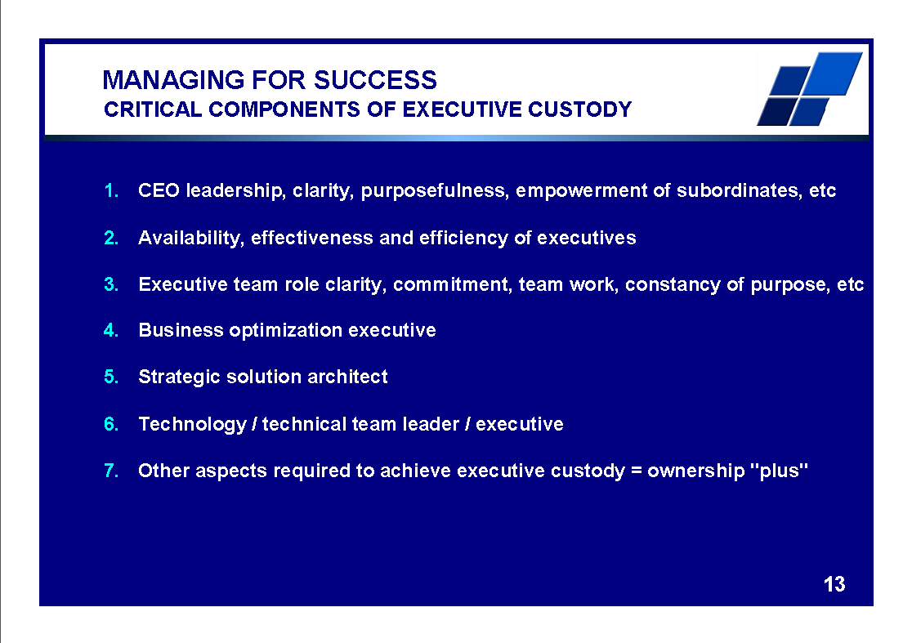
There IS great opportunity
ERP can and should add value
Notes:
Professor Richard Nolan states that "I.T. is the next corporate disaster waiting to happen”
And postulates that soon there will be an Enron level corporate failure
Do you remember Fedsure Health – tell the story SHORT

Slide 47
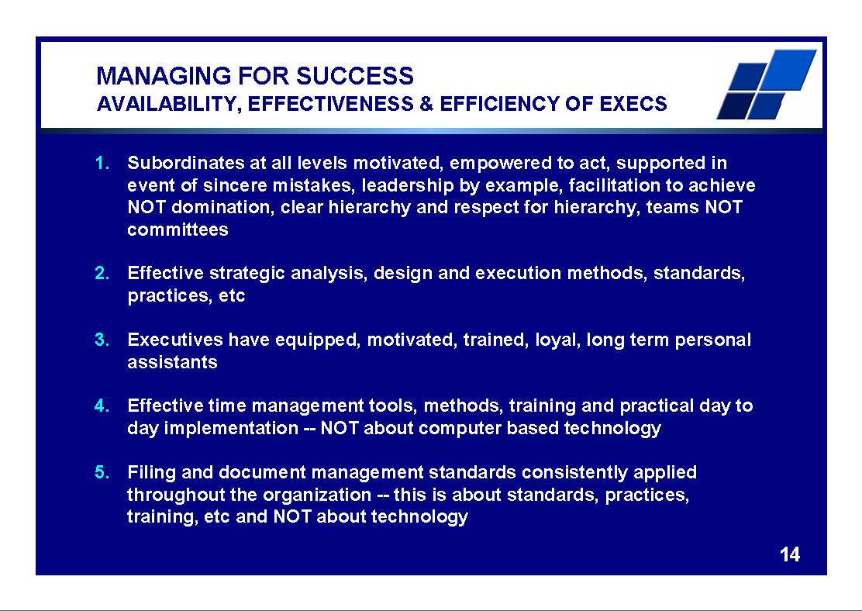
There IS great opportunity
ERP can and should add value
Notes:
Professor Richard Nolan states that "I.T. is the next corporate disaster waiting to happen”
And postulates that soon there will be an Enron level corporate failure
Do you remember Fedsure Health – tell the story SHORT

Slide 48
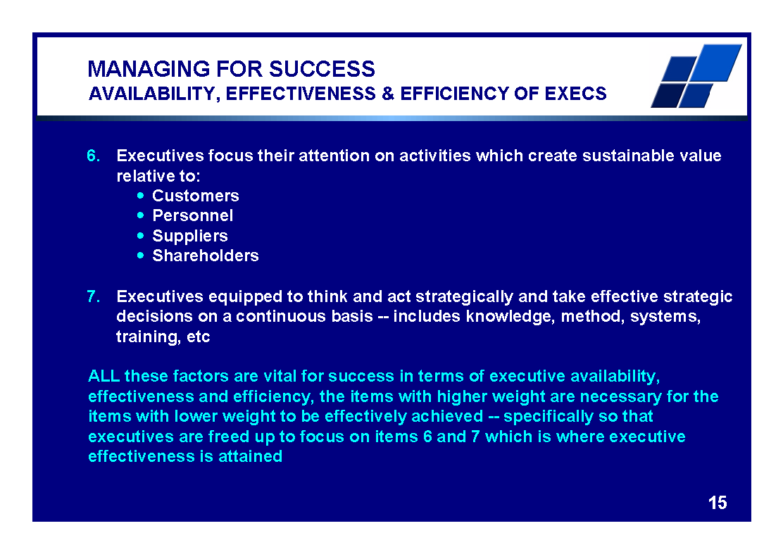
There IS great opportunity
ERP can and should add value
Notes:
Professor Richard Nolan states that "I.T. is the next corporate disaster waiting to happen”
And postulates that soon there will be an Enron level corporate failure
Do you remember Fedsure Health – tell the story SHORT

Slide 49
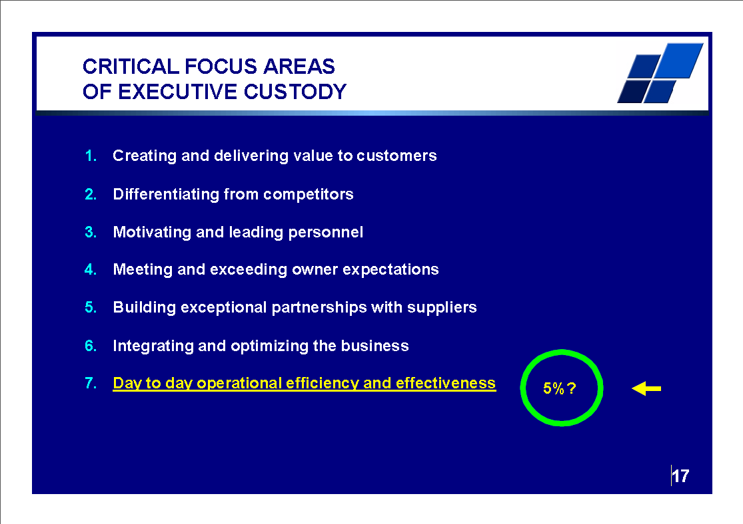
There IS great opportunity
ERP can and should add value
Notes:
Professor Richard Nolan states that "I.T. is the next corporate disaster waiting to happen”
And postulates that soon there will be an Enron level corporate failure
Do you remember Fedsure Health – tell the story SHORT

Slide 50
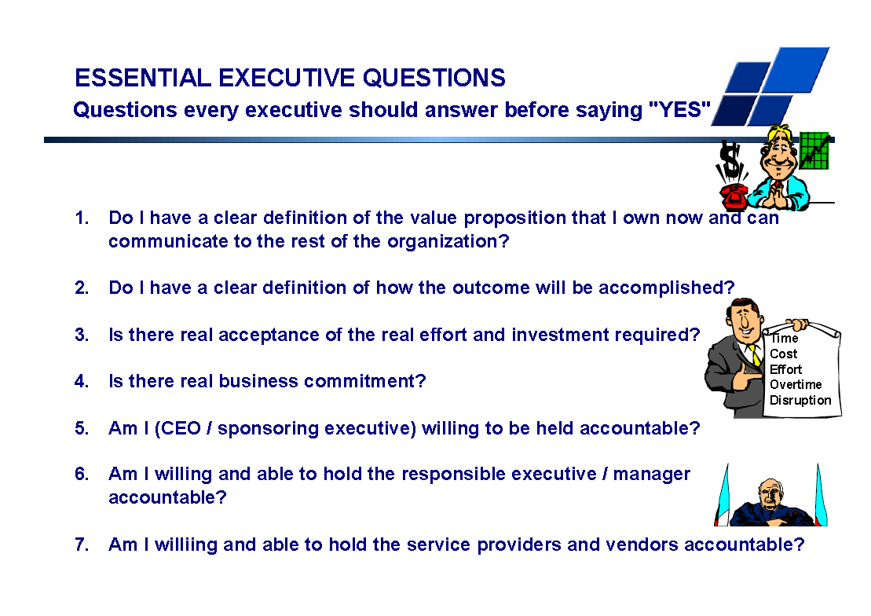
There IS great opportunity
ERP can and should add value
Notes:
Professor Richard Nolan states that "I.T. is the next corporate disaster waiting to happen”
And postulates that soon there will be an Enron level corporate failure
Do you remember Fedsure Health – tell the story SHORT

Slide 51
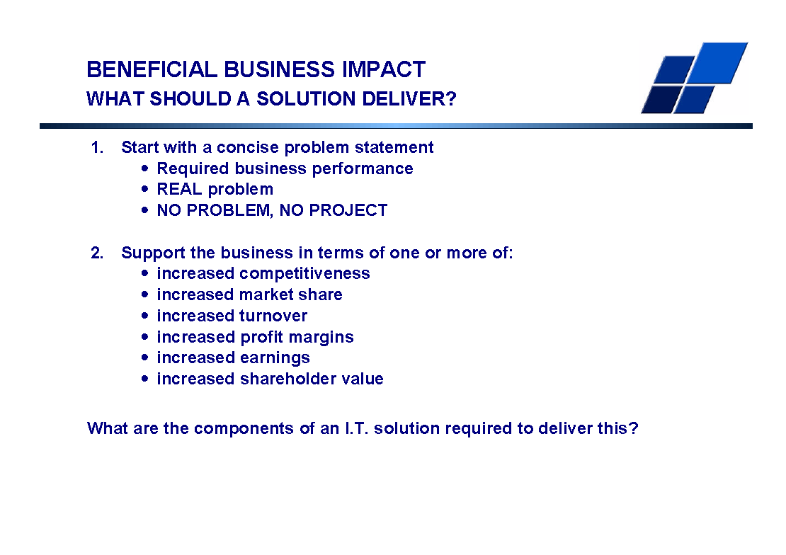
There IS great opportunity
ERP can and should add value
Notes:
Professor Richard Nolan states that "I.T. is the next corporate disaster waiting to happen”
And postulates that soon there will be an Enron level corporate failure
Do you remember Fedsure Health – tell the story SHORT

Slide 52
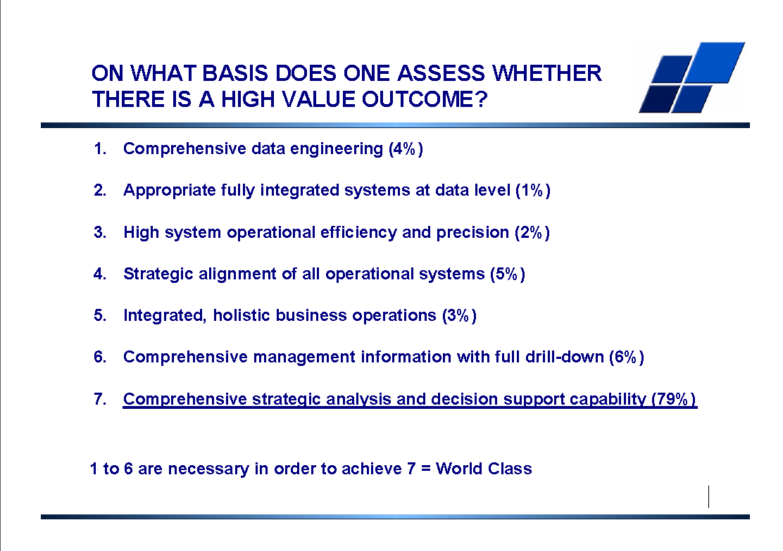
e
Notes:
Professor Richard Nolan states that "I.T. is the next corporate disaster waiting to happen”
And postulates that soon there will be an Enron level corporate failure
Do you remember Fedsure Health – tell the story SHORT

Slide 53
Agenda
Executive Custody -- what is it and
how do you get it?
Context and definitions
What IS Executive Custody
What is NOT Executive Custody
Why the CEO MUST be custodian of strategic change (and therefore ERP) projects
How to support the CEO to make this practical

Slide 54
Executive Custody
How to support the CEO
For a project – similar for operations
Senior trusted advisor, may be part time
DOER to run the project – project leader or contract manager
Effective strategically focused (essence of the business) procurement that maximizes shedding of risk to the implementer through tough contractual terms including a legally binding fixed price
CEO must ask questions till he understands and, if necessary, bring in further advisors until he has answers that MAKE SENSE and that he understands and that correlate with the REAL world
Implementer team leader is a director – can talk to CEO at a peer level
Effective communication

Slide 55
Agenda
Executive Custody -- what is it and
how do you get it?
Context and definitions
What IS Executive Custody
What is NOT Executive Custody
Why the CEO MUST be custodian of strategic change (and therefore ERP) projects
How to support the CEO to make this practical
Some simple techniques

Slide 56
Executive Custody
Simple techniques
Project leader – head round the door start and end of the day
Phone if head round the door is not possible
Copy CEO with ALL emails – does NOT have to read, scan subject lines and drill down as necessary – few minutes a day
Weekly one on one briefing for one hour
Nominally chairs weekly project meeting, may delegate to Project Leader BUT still in the room – project leader draws authority from mandate
CEO Chairs monthly Project Board meetings
Periodic detailed walkthroughs of the configuration with ALL relevant executives and managers
If this is too much then you probably do NOT require a new ERP

Slide 57
Agenda
Executive Custody -- what is it and
how do you get it?
Context and definitions
What IS Executive Custody
What is NOT Executive Custody
Why the CEO MUST be custodian of strategic change (and therefore ERP) projects
How to support the CEO to make this practical
Some simple techniques
Summing up

Slide 58
The fundamental requirements for an ERP
ONLY possible if the CEO takes custody
The answers to questions I have not yet thought to ask
Enable me to run the business MY way
Accurately model every aspect of my business
Totally integrated solution
Entirely reliable and dependable
Fundamentally support the essence of the business and how it thrives (strategy)
Fully support my day to day operational functions

Slide 59

Summing up
Better DECISIONS
The CEO OWN’s the strategic “helicopter view” of the business – CEO custody is therefore NOT NEGOTIABLE
Only the CEO can “kick butt” to get executives and their silo’s to work together
To get executive intelligence OUT you must put executive intelligence IN – only the CEO has the complete picture
This is NOT a LOT of work, it is working clever
The magnitude of the investment warrants the time investment
The scale of the downside risk warrants the time investment
A significant opportunity to get more out of your current systems

Slide 60

If you do not act within 48 hours you probably never will – act TODAY! ☺
What is your single most important insight from this presentation?
What is the single most practical action that you can take tomorrow to apply ERP more effectively?
Please write down your thoughts
NOW
    James@Webinars-at-JARA.com

Slide 61


Questions?
We will email you my book, hand-outs and
link to the recording of this presentation
JAR&A are available to assist in applying these principles
"To Him who by wisdom made the heavens, for His mercy endures forever;"
Dr James Robertson PrEng – The ERP Doctor -- Mobile: +27-(0)83-251-6644
www.James-A-Robertson-and-Associates.com
James@JamesARobertson.com
LinkedIn: http://za.LinkedIn.com/in/DrJamesARobertsonERPDoctor
Assisting clients to thrive through the effective application of IT and ERP

